Slide 1
OPC UA Liaision
Sebastian Käbisch | Siemens AG
November 14, 2025

Slide 2


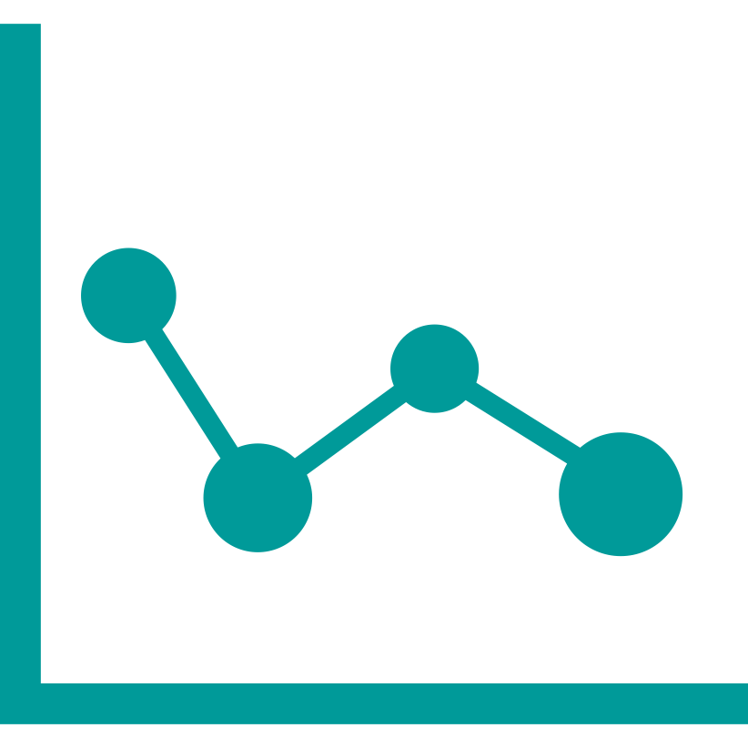

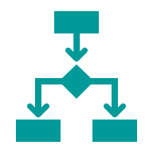

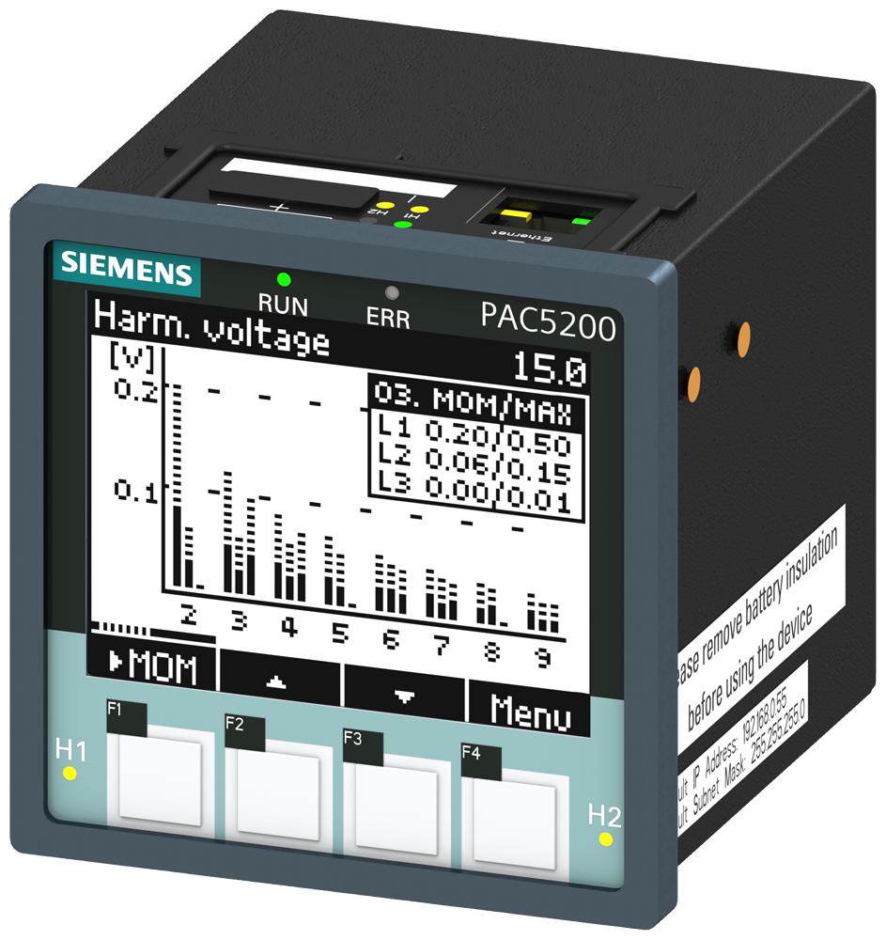
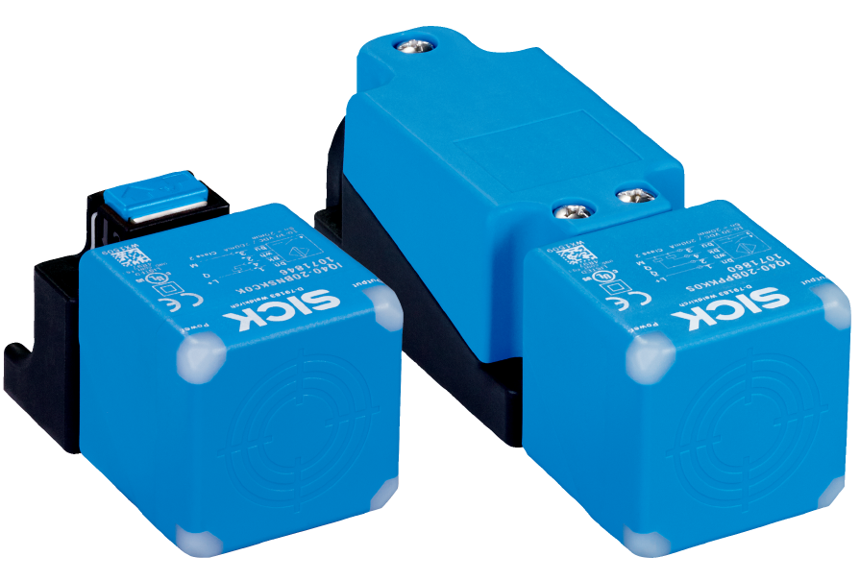
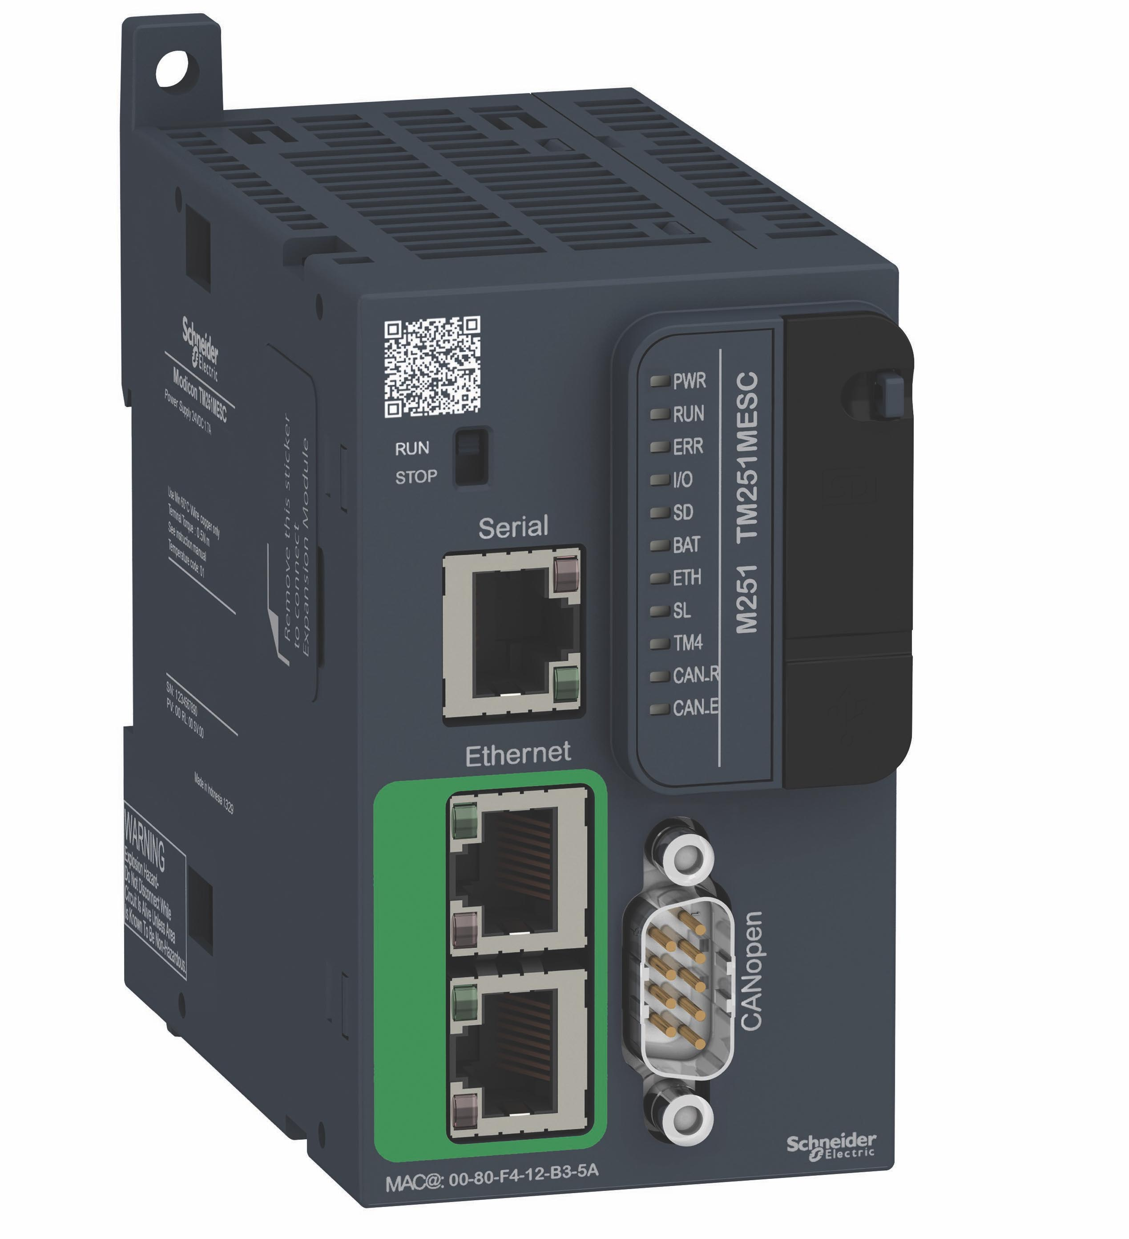
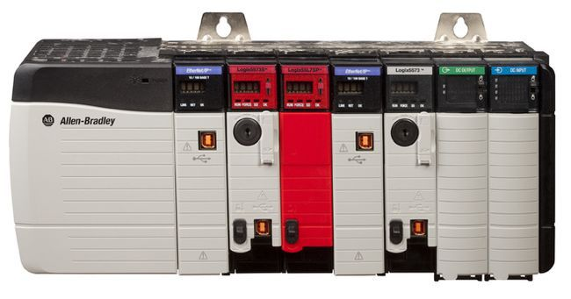
Example Use Case: Industrial Asset Onboarding to OPC UA
Target application based on OPC UA communication
…
Monitoring
Controlling
Cloud Services
Normalized, standardized,
open data model & interface for all assets, including security!
Time & cost-intensive* integration due to the heterogeneous data models, protocols and security requirements of the shop floor
…
*Softing AG at “Beyond IoT 2025”: Up to 4000,- EUR per asset

Slide 3
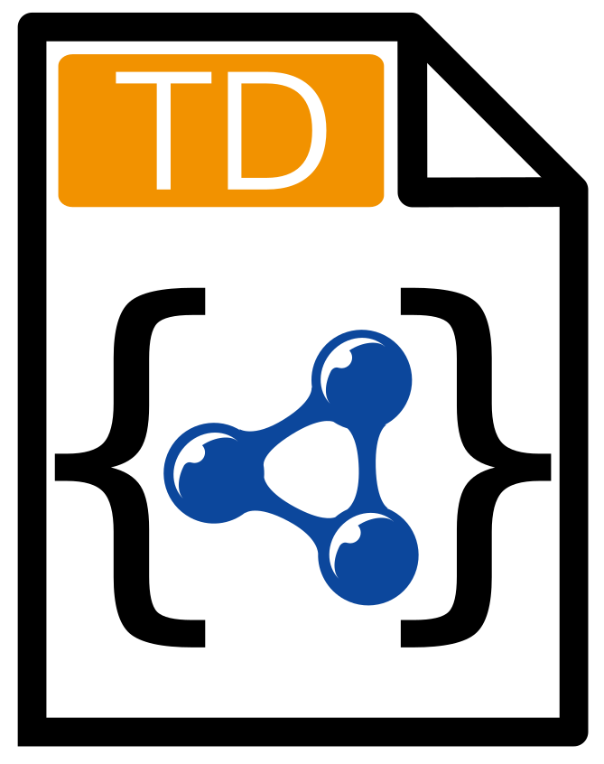
Solution: WoT TD can be used for Asset Onboarding
Target application based on OPC UA communication
…
Monitoring
Controlling
Cloud Services
Normalized, standardized,
open data model & interface for all assets, including security!
WoT Thing Description
enables auto IoT asset onboarding + enables rich semantic annotation
…

Slide 4
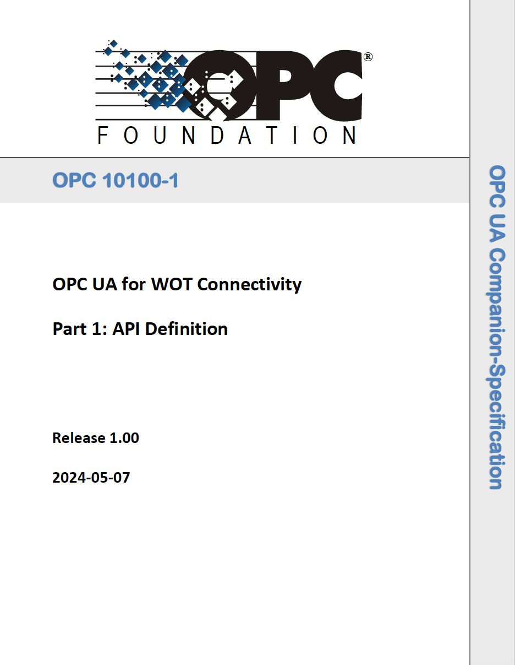
Enter OPC UA for WoT Connectivity
WG lead by Erich Barnstedt (Microsoft)
Main goal: simplify the asset onboarding by the usage of the WoT Thing Description Standard
Version 1.1 available
Currently working on Version 1.2
Welcome to join: Bi-weekly on Tuesday, 3-4CET (next meeting October 14, 2025)
1.0 + 1.1 Available

Slide 5



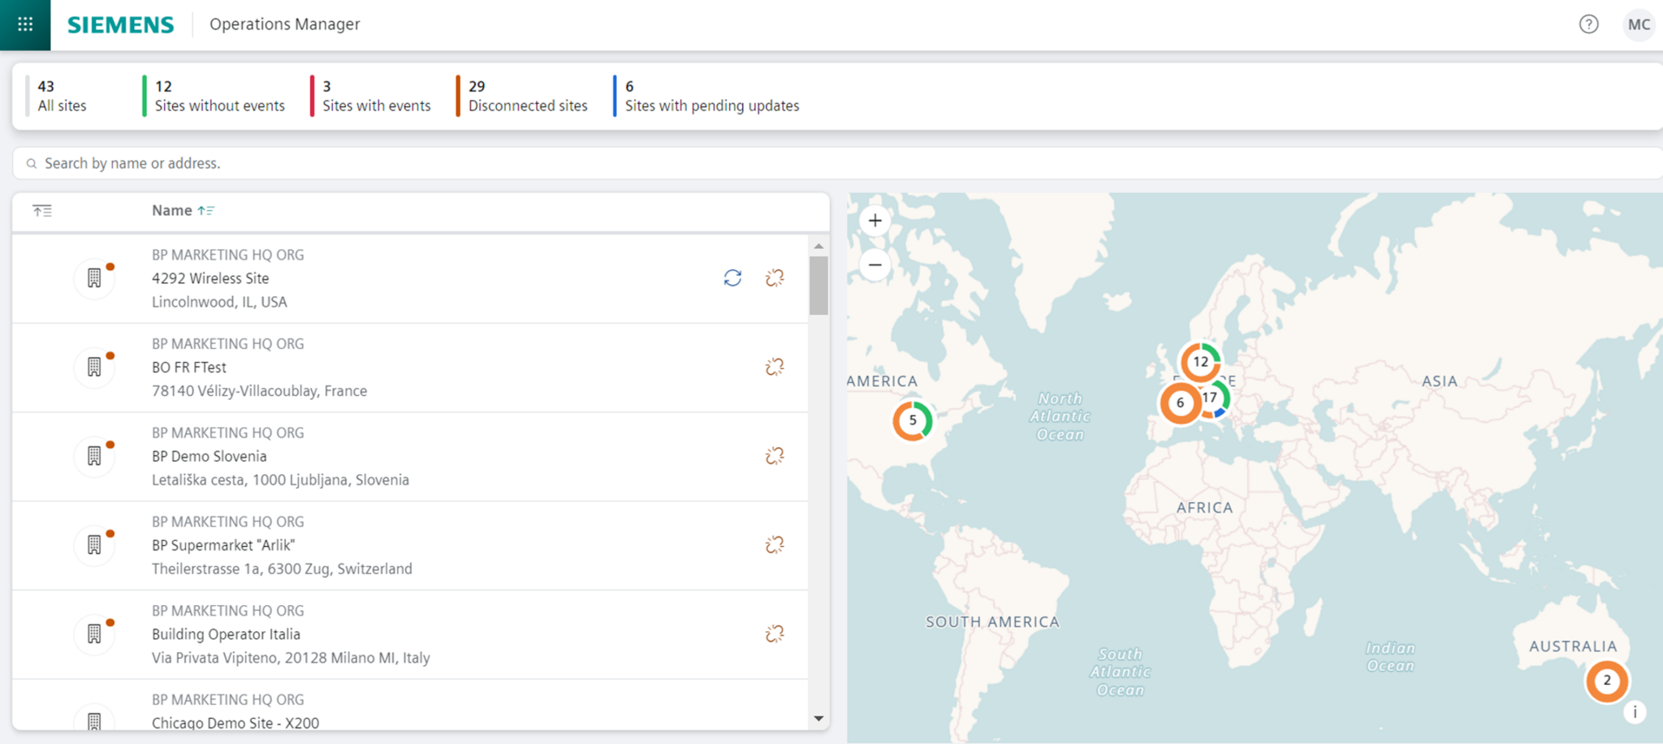
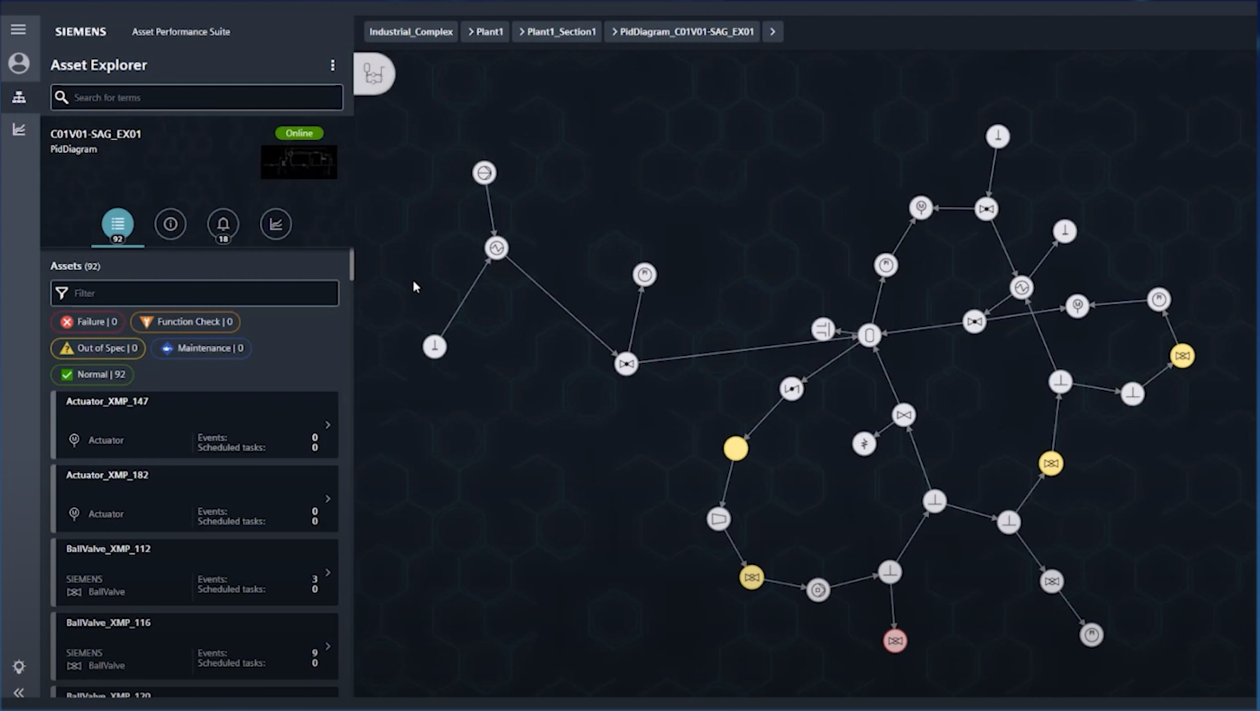
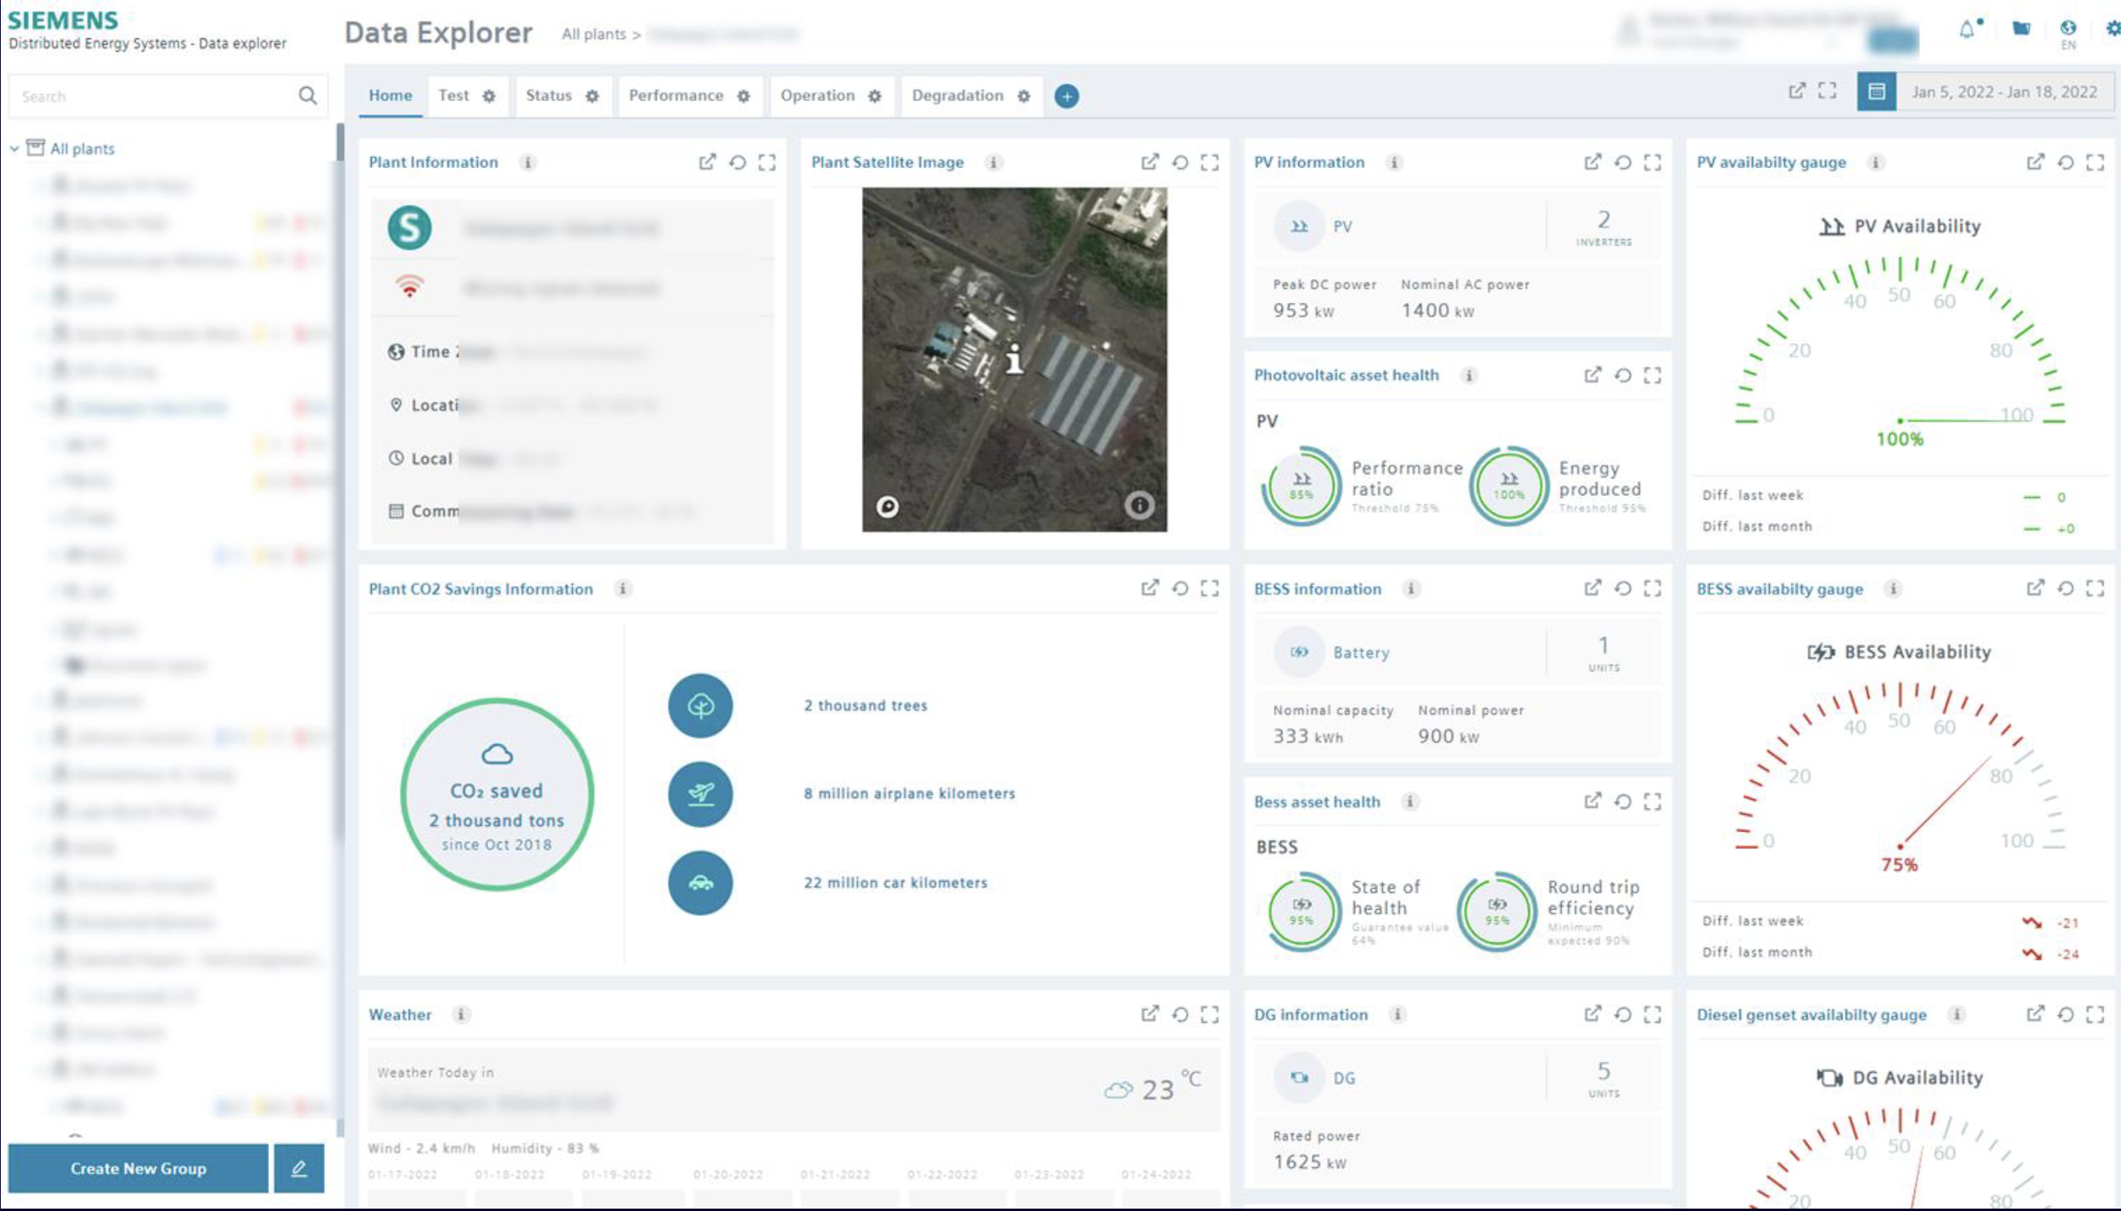
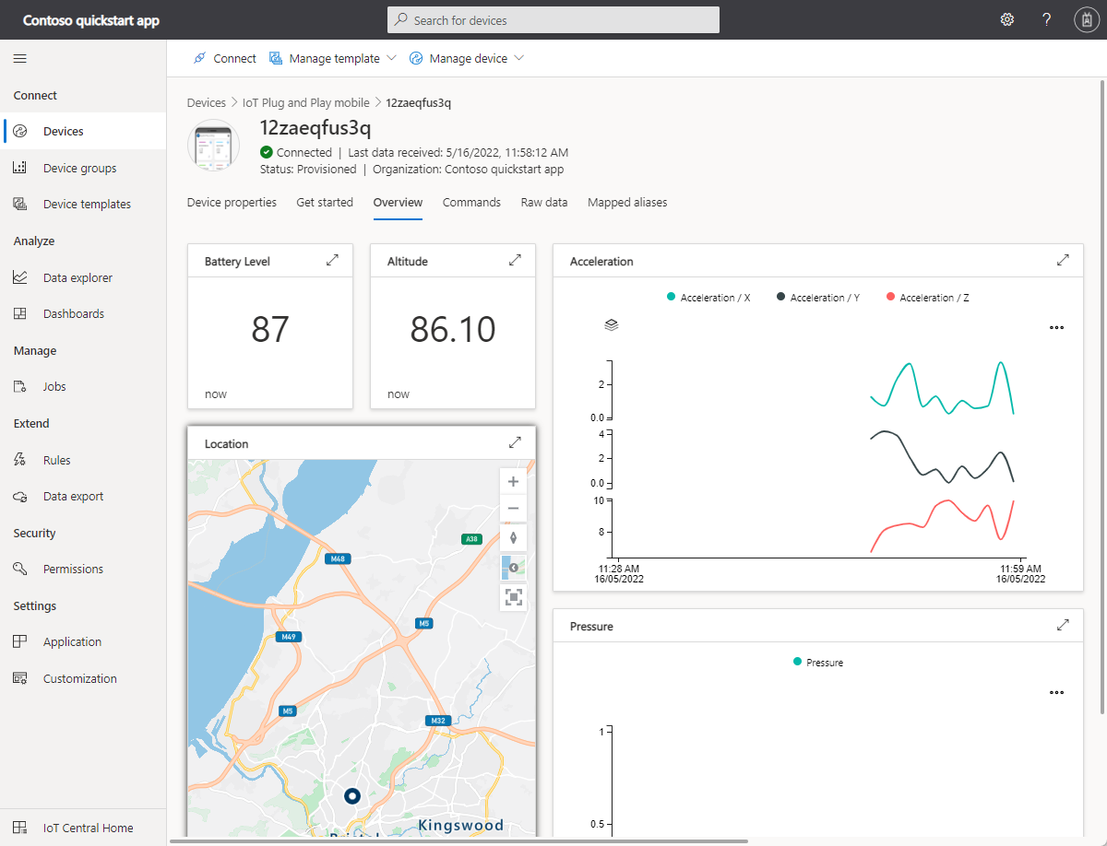
Motivations
OPC UA ecosystem
Non OPC UA ecosystem
…
BACnet
Monitoring
Controlling
Cloud Services
HTTP
OCPP
Simple integration of OPC UA system into non-OPC UA ecosystem (e.g., for cross domain scenarios)
Describe in a lightweight style an OPC UA interfaces in JSON based format
Allow to define a specific subset of the UA data model that should be used for target application
Allow semantic annotations based on RDF
…

Slide 6
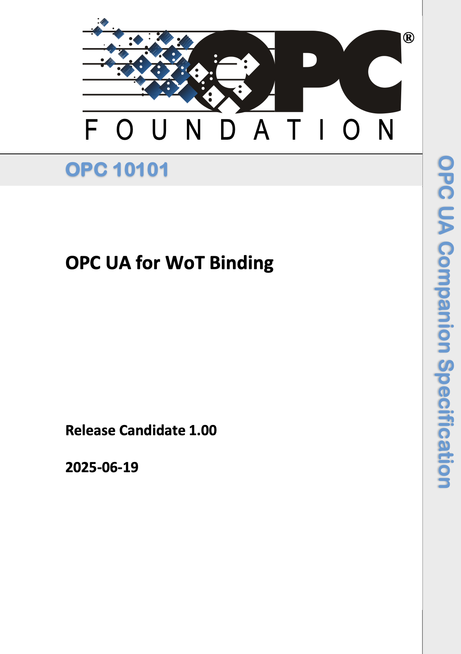
Enter OPC UA for WoT Binding
WG lead by Sebastian Käbisch (Siemens); Co-lead by Erich Barnstedt (Microsoft)
Main goal: describe how the WoT Thing Description should be specified to describe an OPC UA interface
TAG review completed
Bi-weekly on Tuesday, 4-5CET (next meeting October 21)
Soon

Slide 7
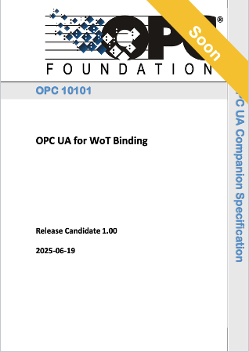
Use WoT Thing Description to describe OPC UA interface
OPC UA ecosystem
Non OPC UA ecosystem
…
BACnet
Monitoring
Controlling
Cloud Services
HTTP
OCPP
…

Slide 8
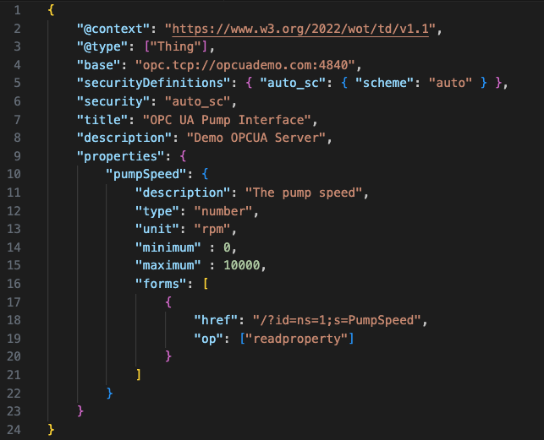
Example (Minimal)
UA server location
UA security mode
UA Variable
UA nodeId (also nsu representation is possible)
Access level
Notes:
{
"@context": "https://www.w3.org/2022/wot/td/v1.1",
"@type": ["Thing"],
"base": "opc.tcp://opcuademo.com:4840",
"securityDefinitions": { "auto_sc": { "scheme": "auto" } },
"security": "auto_sc",
"title": "servient",
"description": "Demo OPCUA Server",
"properties": {
"pumpSpeed": {
"description": "The pump speed",
"type": "number",
"unit": "rpm",
"minimum" : 0,
"maximum" : 10000,
"forms": [
{
"href": "/?id=ns=1;s=PumpSpeed",
"op": ["readproperty"]
}
]
}
}
}

Slide 9
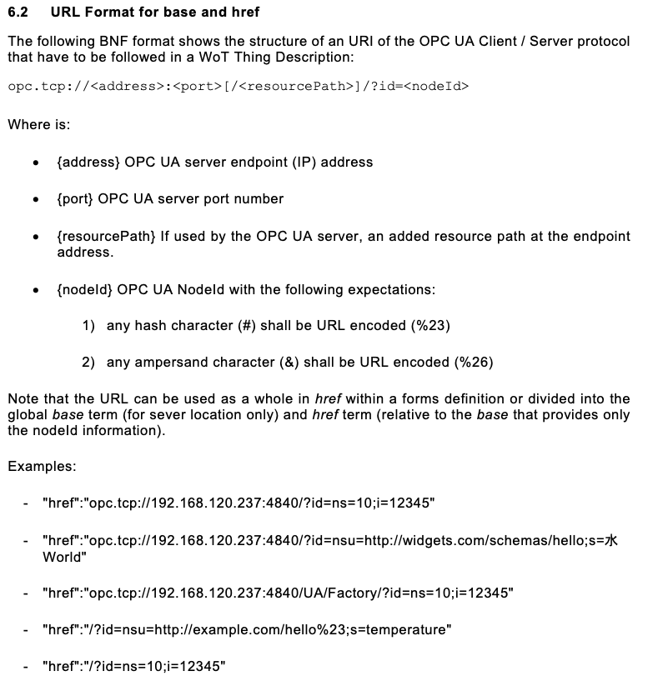
URL Scheme

Slide 10
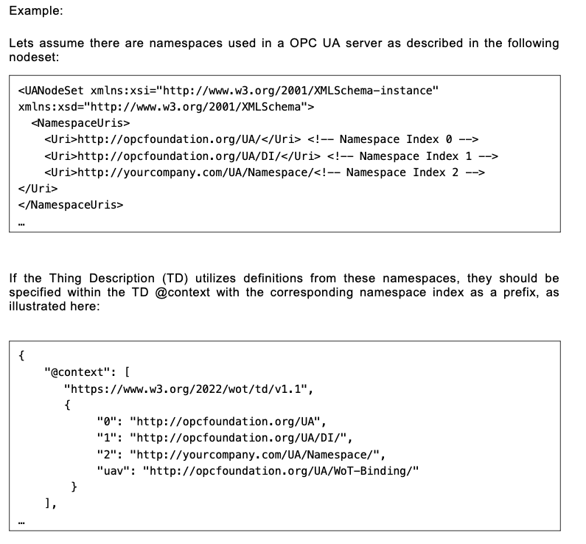
Namespaces (see Section 6.5.5)

Slide 11
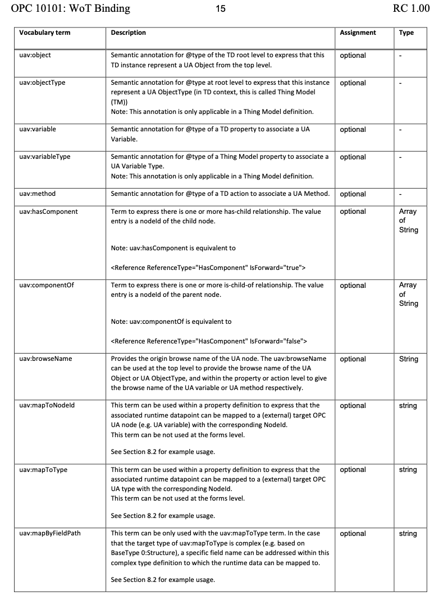
OPC UA Terms for annotating Thing Descriptions (from 6.5.4)

Slide 12
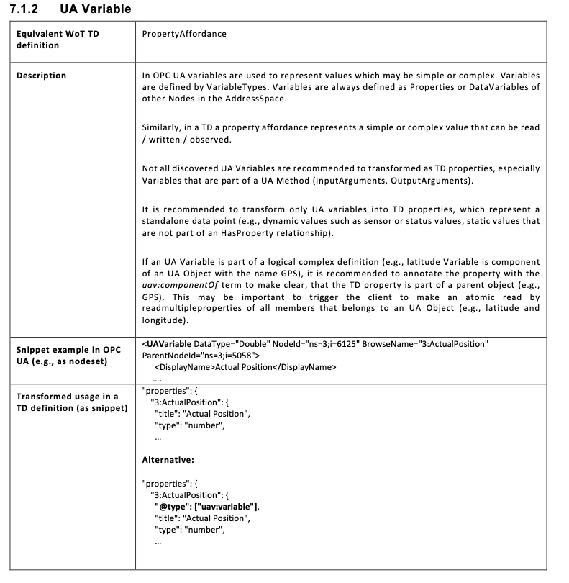
Thing Description Mapping from OPC UA Core Definition (Example UA Variable; Chapter 7)

